Slide 1
Project Presentation of Industry Oriented Hands on Experience (22CS422)
On
Cyber Crisis Management Using The Nist CSF 2.0
Janvi Sethi 2210990431
Kanwardeep Singh 2210990473
Yashasvi 2210992562
Supervised By
Gurpreet Singh
Department of Computer Science and Engineering,
Chitkara University, Punjab

Slide 2
Introduction
Digital transformation has increased organizational dependence on technology, expanding opportunities for cyberattacks.
Cyber crises now affect all sectors, including healthcare, finance, government, and industry.
Major incidents such as the Colonial Pipeline ransomware attack, SolarWinds supply chain attack, and MOVEit Transfer vulnerability exploitation highlight the growing impact of cybercrime.
Cyber Crisis Management (CCM) helps organizations prepare for, detect, respond to, and recover from cyber incidents while reducing operational and reputational damage.
Unlike traditional incident response, CCM integrates governance, legal compliance, communication, and business continuity.
The National Institute of Standards and Technology Cybersecurity Framework (NIST CSF), updated in 2024, provides a widely adopted lifecycle-based approach for managing cybersecurity risks.

Slide 3
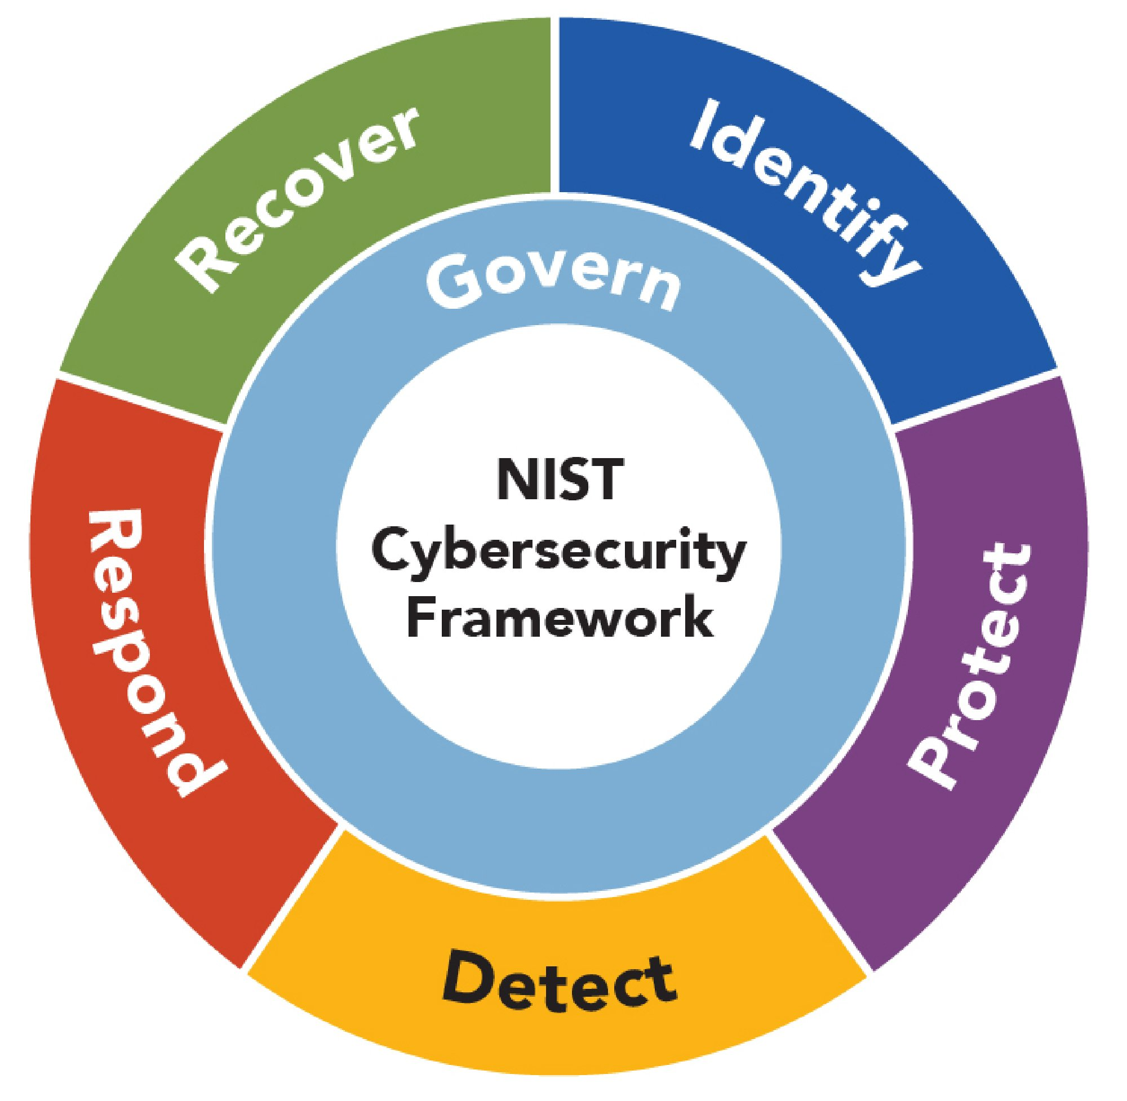
Objective
To analyze the growing importance of Cyber Crisis Management (CCM) in modern organizations.
To study the role of the National Institute of Standards and Technology Cybersecurity Framework (NIST CSF 2.0) in managing cyber crises.
To examine key CCM functions such as governance, identify, protection, detection, response and recovery.
To identify strategies for improving organizational resilience, business continuity, and incident response capabilities.
To understand the importance of continuous improvement and adaptive cybersecurity practices in evolving threat environments.

Slide 4
Literature Review
Research highlights the growing importance of Cyber Crisis Management (CCM) in strengthening organizational resilience against evolving cyber threats.
Studies emphasize the role of standards-based frameworks, especially the National Institute of Standards and Technology Cybersecurity Framework (NIST CSF), in improving risk management and incident response capabilities.
Prior literature identifies effective incident response, governance, and threat intelligence as key factors in minimizing operational and reputational damage during cyber crises.
Also discuss emerging risks from AI-driven attacks, cloud systems, supply chain vulnerabilities, and critical infrastructure threats.
Overall, the literature supports the need for integrated, continuously evolving cybersecurity and crisis management strategies.

Slide 5
Data Analysis
Threat Category | Avg. Financial Impact | Avg. Dwell Time | Trend | Source
Ransomware | $5.68M | 49 days | ↑ Rising | [2][4]
Phishing/Social Engineering | $4.76M | 24 days | ↑ Rising | [2][4]
Supply Chain Attack | $4.46M | 197 days | ↑ Rising | [2][4]
Insider Threat | $4.90M | 85 days | → Stable | [2][4]
Zero-Day Exploits | $4.55M | 132 days | ↑ Rising | [2][4]
(Source: IBM Cost of a Data Breach 2024 [2]; Mandiant M-Trends 2024 [4])

Slide 6
Conclusion
Cyber Crisis Management (CCM) is now a critical business function combining technology, governance, legal compliance, business continuity, and communication.
The National Institute of Standards and Technology Cybersecurity Framework (NIST CSF 2.0) provides a comprehensive approach through six core functions: GOVERN, IDENTIFY, PROTECT, DETECT, RESPOND, and RECOVER.
CSF 2.0 emphasizes leadership involvement and organizational resilience, not just technical security controls.
Organizations with tested incident response plans experience lower breach costs, faster recovery, and stronger stakeholder trust.
Emerging challenges such as AI-driven attacks, quantum computing, OT vulnerabilities, and geopolitical cyber threats require continuous improvement in CCM strategies.
Long-term cyber resilience depends on well-coordinated, regularly tested, and continuously enhanced crisis management capabilities.

Slide 7
Future Scope & Research Directions
Future CCM strategies must address emerging threats such as AI-driven cyberattacks, deepfakes, automated malware, and advanced social engineering.
AI will also strengthen cyber defense through automated detection, threat analysis, and faster incident response.
Quantum computing introduces long-term cryptographic risks, requiring organizations to adopt quantum-safe security measures.
Increasing attacks on critical infrastructure and OT/ICS systems demand integrated IT–OT crisis management approaches.
Cybersecurity is shifting from prevention-focused security to resilience-based security, emphasizing rapid detection, response, recovery, and adaptability.
The National Institute of Standards and Technology Cybersecurity Framework (NIST CSF 2.0) supports this resilience-focused approach for future cyber crisis management.

Slide 8
References
[1] National Institute of Standards and Technology (US). (2024). NIST Cybersecurity Framework 2.0: Quick-Start Guide for Creating and Using Organizational Profiles. US Department of Commerce, National Institute of Standards and Technology.
[2] IBM Security. (2024). Cost of a Data Breach Report 2024. IBM Corporation.
[3] Lochstampfor Jr, C. (2025). Network & Cyber Security: Tools, Costs, and Efficiency.
[4] Mandiant. (2024). M-Trends 2024: Special Report. Google LLC. Retrieved from https://www.mandiant.com/resources/reports/m-trends-2024
[5] Kim, K., Lee, S., Ramachandran, S., & Alzahrani, I. (2025). Cryptocurrency-driven ransomware syndicates operating on the darknet: A focused examination of the Arab world. Egyptian Informatics Journal, 30, 100665.
[6] Babu, M., & Moharir, M. (2024, November). Leveraging XGBoost Machine Learning Algorithm for Common Vulnerabilities and Exposures (CVE) Exploitability Classification. In 2024 8th International Conference on Computational System and Information Technology for Sustainable Solutions (CSITSS) (pp. 1–6). IEEE.
[7] Cichonski, P., Millar, T., Grance, T., & Scarfone, K. (2012). Computer Security Incident Handling Guide. NIST Special Publication 800-61, 1–147.
[8] National Institute of Standards and Technology. (2023). Artificial Intelligence Risk Management Framework (AI RMF 1.0). https://nvlpubs.nist.gov/nistpubs/ai/nist.ai.100-1.pdf

Slide 9
References
[9] Alagic, G., Bros, M., Ciadoux, P., Cooper, D., Dang, Q., Dang, T., & Waller, N. (2025). Status Report on the Fourth Round of the NIST Post-Quantum Cryptography Standardization Process. US Department of Commerce, National Institute of Standards and Technology.
[10] Ciekanowski, Z., Gruchelski, M., Nowicka, J., Zurawski, S., & Pauliuchuk, Y. (2023). Cyberspace as a Source of New Threats to the Security of the European Union.
[11] PricewaterhouseCoopers. (2024). Global Digital Trust Insights 2024: A C-Suite United on Cyber-Ready Futures. PwC.
[12] Hassan, O. A., & Khadaroo, I. (2026). A Critical Analysis of Microsoft's Rhetoric and Reality of Sustainability Engagement. Business Strategy and the Environment.
[13] Manoharan, A. (2024). Understanding the threat landscape: A comprehensive analysis of cyber-security risks in 2024. International Research Journal of Modernization in Engineering Technology and Science, 6(3), 5706–5713.
[14] Lee, H., Yoon, S., Lee, Y., & Kang, J. (2026). Enhancing RMF and ATT&CK Mapping Accuracy through Sentence-BERT and Mitigation Parameters Integration.
[15] Rossi, M. C. (2023). Enhancing Cyber Assets Visibility for Effective Attack Surface Management.
[16] Cichonski, P., Millar, T., Grance, T., & Scarfone, K. (2012). Computer Security Incident Handling Guide. NIST Special Publication 800-61, 1–147.

Slide 10
References
[17] Perlroth, N. (2021). This Is How They Tell Me the World Ends: The Cyberweapons Arms Race. Bloomsbury Publishing USA.
[18] Staves, A. J. (2023). Operational Technology Preparedness: A Risk-Based Safety Approach to Scoping Security Tests for Cyber Incident Response and Recovery. Lancaster University (United Kingdom).
[19] Poetiray, I. F. Z., & Salman, M. (2023). Information security incident management using ISO 27035 standard. Gema Wiralodra, 14(3), 168–178.
[20] Lim, I. C. Cybersecurity in an Age of Complexity: Outlook Since 2022 and What to Do Next

Slide 11
Thank You

